Slide 1
poultry diseases fourth stage
Necropsy Technique.
By Dr. Isam Azeez
Department of Pathology and Poultry Diseases
College of Veterinary Medicine university of Basrah

Slide 2
Ways autopsy and examination:
1. Dipping birds in the water or sterile solution after their death and before an autopsy.
Advantage
Reduces the contamination of the internal organs with dust and dirty feathers.
Prevents the spread of soft feathers and dust in the autopsy room.
Avoid inhalation of delicate feathers, as dust may lead to the transmission of
some diseases or allergies to feathers.

Slide 3
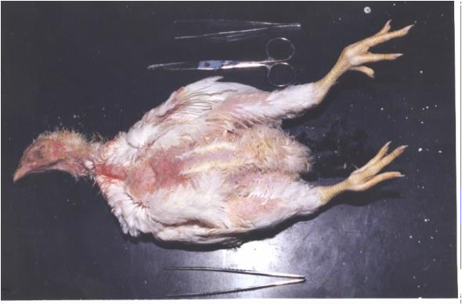
2-Place the bird on his back and pull the legs to the side and the back.

Slide 4
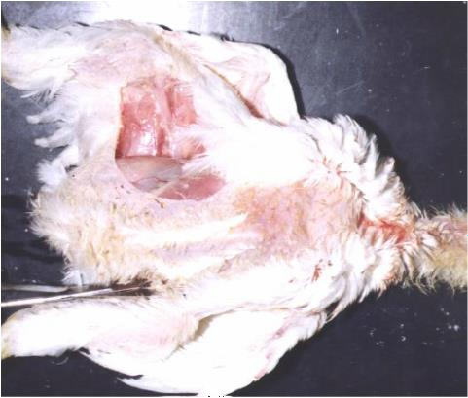
3- Cut the skin from the end of the keel bone between the legs and abdomen on each side

Slide 5
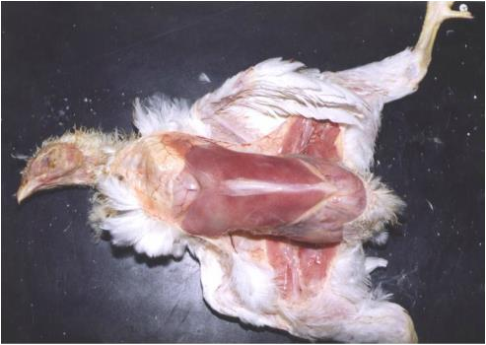
4- Raise the skin over the thigh and chest, withdraw, and check the thigh and chest muscles. Then, check the sternum bone and the surrounding area.

Slide 6
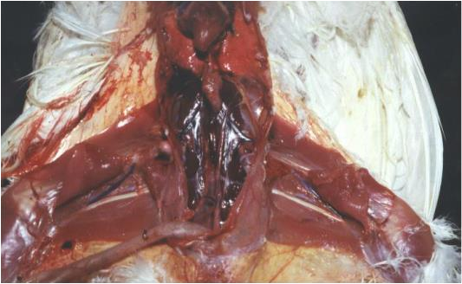
5- Lift the inner thigh muscles or cut them down and check the sciatic nerve, which is located underneath.

Slide 7
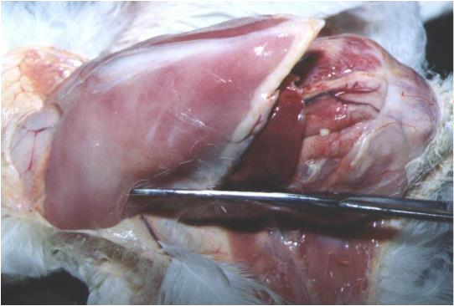
6- Cut the abdomen gently in a cross-sectional area at the end of the sternum to gain access to internal organs (viscera).

Slide 8
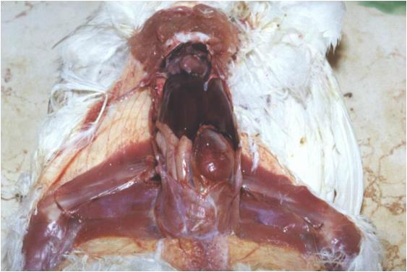
7- Raise the chest and show guts in front of you. Check the viscera in a place.

Slide 9
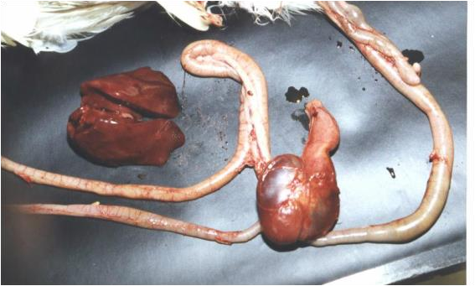
8- Cut the area between the proventriculus and esophagus, then raise the proventriculus and gizzard, liver, spleen, and intestines. Put the outside rectum is still connected to the body of the bird

Slide 10
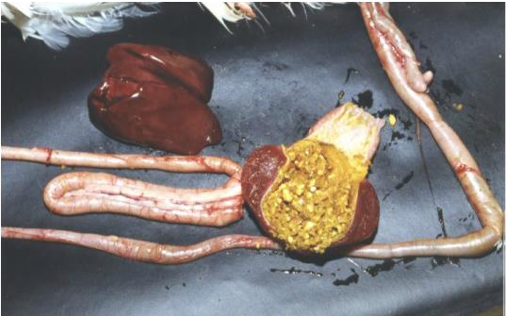
9- Check the outer surface of the liver, and then cut the liver.

Slide 11
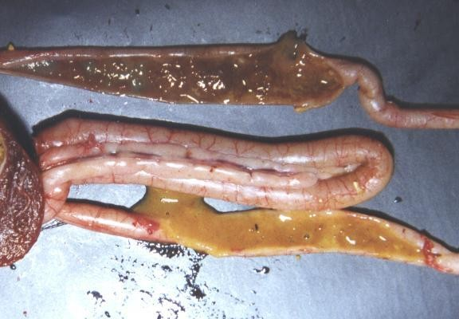
10- Examine the serosal surface of the intestine. Check the yolk sac, if any. Open
the small intestine and ceca and inspect the contents and mucosal surface for them.

Slide 12
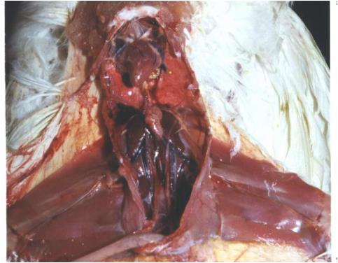
11- Check the heart and the lungs and kidneys and ureters

Slide 13
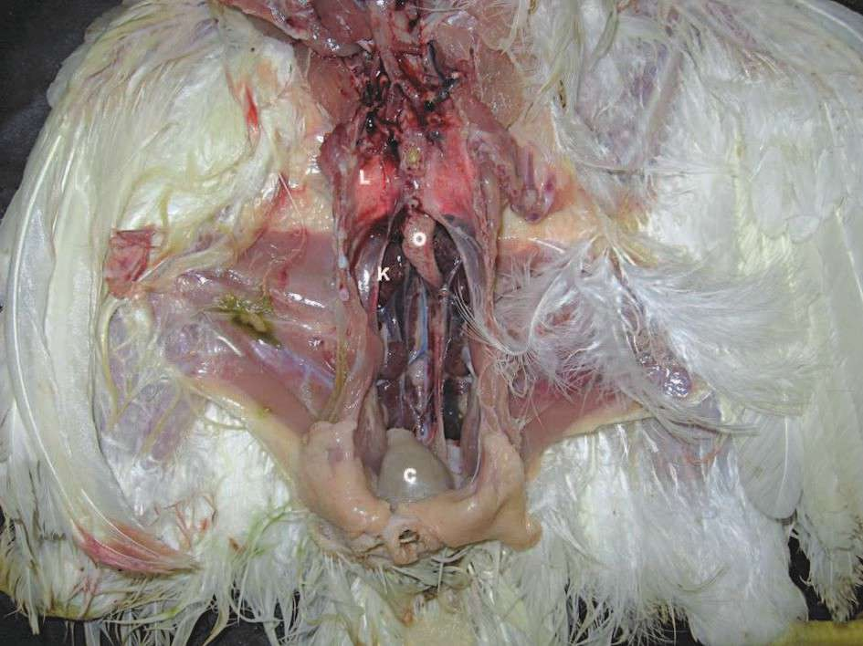
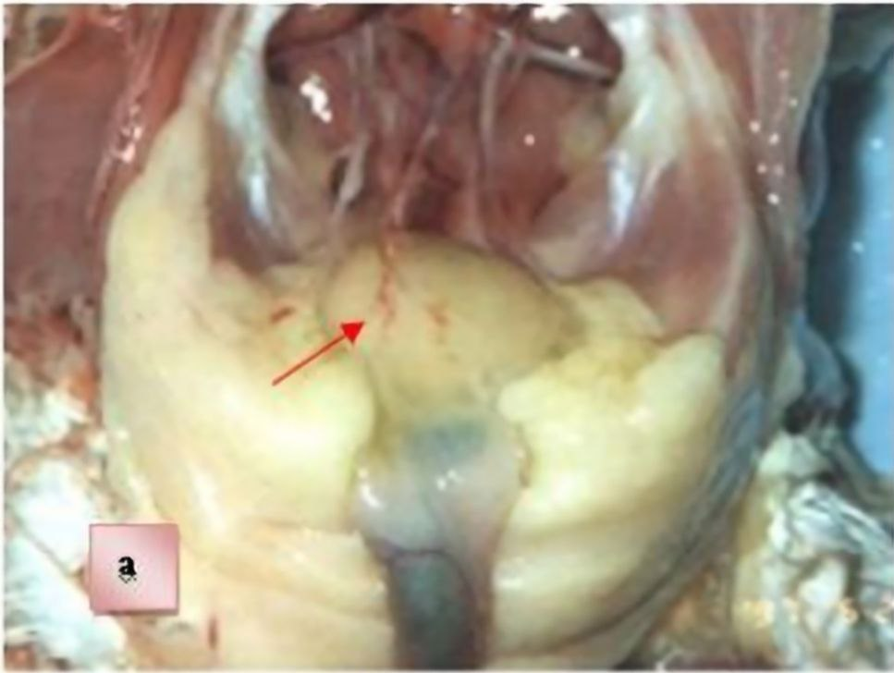
12. Note Exterior Fabricia, then open the bursa and check from the inside.

Slide 14
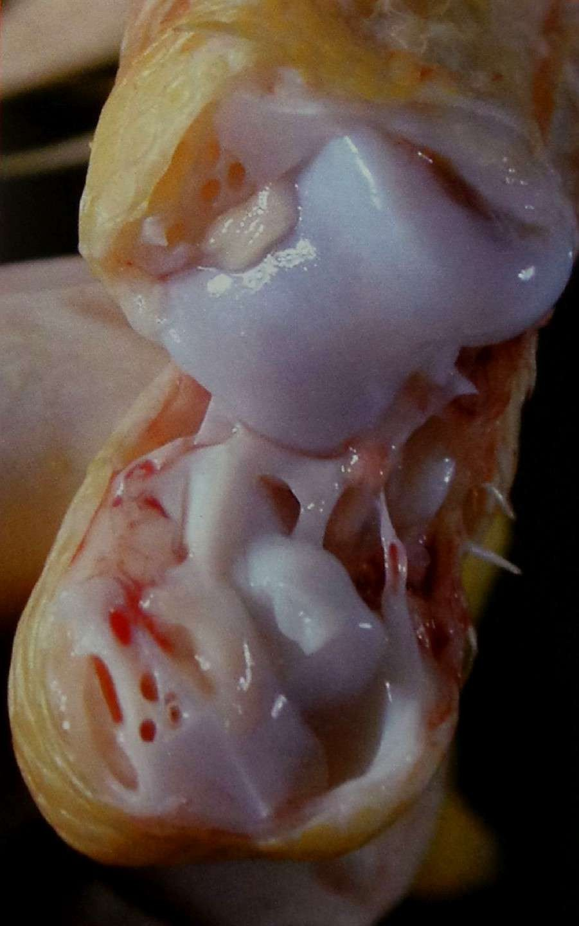
13- Check the joints and bones.

Slide 15
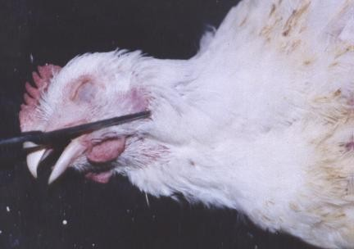
14- Cut through the corner of the mouth. Check the mouth and pharynx.

Slide 16
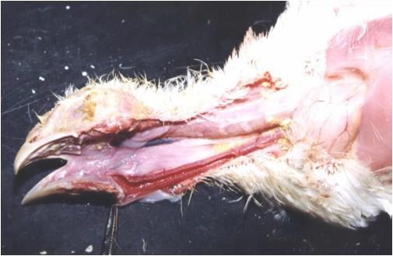
15- Check the mucosa of the esophagus and examine the mucosal surface of
the larynx and trachea

Slide 17
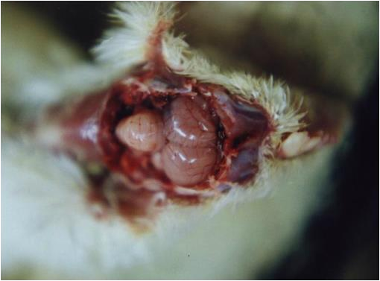
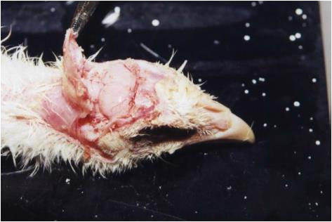
16- Cut the skull bone to examine the brain

Slide 18
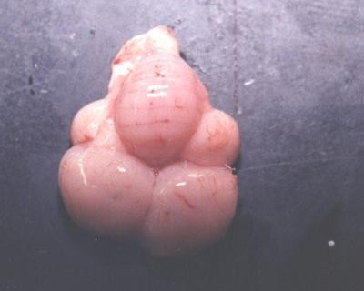
17- After the lifting of the brain, cut the medulla oblongata and down the
brain abroad

Slide 19
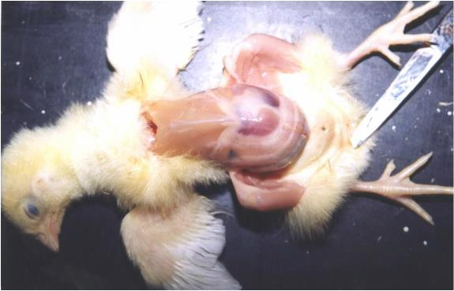
In case of anatomy small Chicks lifted only in the skin begin to examine
the navel area

Slide 20
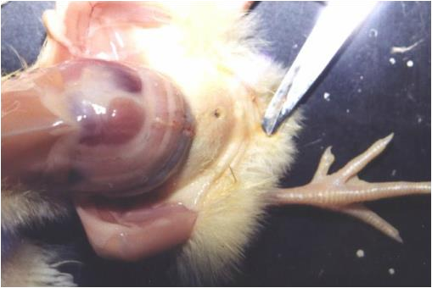
Note to open the navel and under the skin over the abdomen

Slide 21
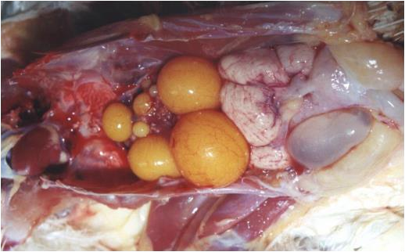
Normal ovary and oviduct of layers chickens in the production.

